Slide 1


MULUNGUSHI UNIVERSITY
School of Engineering and Technology
ICT411 Cloud Computing
Unit 2: Cloud Service & Deployment Models
Lecture 2 • 4th Year Computer Science
Lecturer: Mr. M Bwalya
Notes:
Introduce the unit as the decision-making part of cloud adoption: what service model and what deployment model fit a real workload?

Slide 2

LECTURE 2
Learning outcomes for Unit 2
• Differentiate SaaS, PaaS, IaaS, MaaS, and CaaS using control and responsibility boundaries.
• Compare public, private, hybrid, and community cloud deployment models.
• Identify advantages, disadvantages, risks, and suitable use cases for each model.
• Use examples such as AWS EC2, Azure Virtual Machines, Google Compute Engine, Heroku, Google App Engine, Salesforce, Microsoft 365, Google Workspace, AWS, Azure, and GCP.
• Recommend a model for a realistic organisation and justify the decision professionally.
ICT411 Cloud Computing • Unit 2 • Cloud Service & Deployment Models
2
Notes:
Keep the focus on competency: students should be able to choose and justify, not merely list definitions.

Slide 3
LECTURE 2
Unit roadmap
1
Service model concept
2
SaaS, PaaS, IaaS
3
Other service models
4
Deployment models
5
Practical selection
• We first separate “what service is provided” from “where and how it is deployed”.
• Then we examine each option using definition, advantages, disadvantages, examples, and practical use cases.
• The lesson ends with a scenario where students recommend a cloud approach for a real system.
ICT411 Cloud Computing • Unit 2 • Cloud Service & Deployment Models
3
Notes:
Use the roadmap to prevent confusion between service models and deployment models.

Slide 4
LECTURE 2
Big idea: two decisions in every cloud design
Decision 1
SERVICE MODEL
What level of service do we consume?
Decision 2
DEPLOYMENT MODEL
Where and for whom is the cloud deployed?
• Service model answers: are we using a complete application, an application platform, or raw infrastructure?
• Deployment model answers: is the cloud public, private, hybrid, or shared by a community?
• Good architecture requires both decisions to fit the workload, budget, risk level, skills, and compliance needs.
ICT411 Cloud Computing • Unit 2 • Cloud Service & Deployment Models
4
Notes:
Repeat this sentence: service model is about level of management; deployment model is about ownership and access scope.

Slide 5
LECTURE 2
Service model versus deployment model
Service models define the level of control, management, and flexibility that an organisation has over the cloud infrastructure and services it uses.
Service model examples
SaaS • PaaS • IaaS • MaaS • CaaS
Deployment model examples
Public • Private • Hybrid • Community
• A university may use SaaS for email, PaaS for a student web app, and IaaS for a custom server.
• The same university may place sensitive records in a private cloud while using public cloud for public websites.
• Model selection is a trade-off, not a fixed answer.
ICT411 Cloud Computing • Unit 2 • Cloud Service & Deployment Models
5
Notes:
This slide is based on the attached notes explaining that cloud service models define control, management, and flexibility.

Slide 6
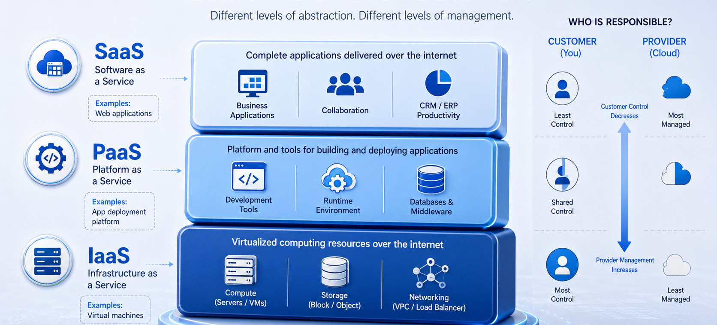
LECTURE 2
Responsibility boundary: who manages what?
ICT411 Cloud Computing • Unit 2 • Cloud Service & Deployment Models
6
Notes:
Explain that SaaS gives the least technical control but the easiest operation, while IaaS gives the most control but requires more management skill.

Slide 7
LECTURE 2
The three main cloud service models
SaaS
Software as a Service
PaaS
Platform as a Service
IaaS
Infrastructure as a Service
Complete application
The provider runs the app and underlying platform. Users access it through a browser, mobile app, or API.
Application platform
The provider manages runtime, middleware, servers, and tools. Developers focus on code and data.
Virtual infrastructure
The provider supplies compute, storage, and network. The consumer manages OS, apps, and configurations.
Key question: how much control do we need, and how much management work can we handle?
ICT411 Cloud Computing • Unit 2 • Cloud Service & Deployment Models
7
Notes:
Use a simple analogy: renting a finished office, renting a workspace with utilities, or renting an empty building shell.

Slide 8
LECTURE 2
SaaS: Software as a Service
• SaaS delivers complete software applications over the internet, commonly through subscription access.
• Users normally access the application through a web browser, mobile app, or API.
• The provider hosts and manages the application, servers, storage, updates, and much of the platform security.
• The consumer focuses on users, roles, data use, configuration, acceptable use, and business processes.
• Typical examples include Salesforce, Microsoft Office 365, and Google Workspace.
SaaS = use the software, do not run the software infrastructure.
ICT411 Cloud Computing • Unit 2 • Cloud Service & Deployment Models
8
Notes:
Explain SaaS with examples students know: Gmail, Google Drive, Microsoft Teams, Zoom, learning management systems, and CRM systems.

Slide 9
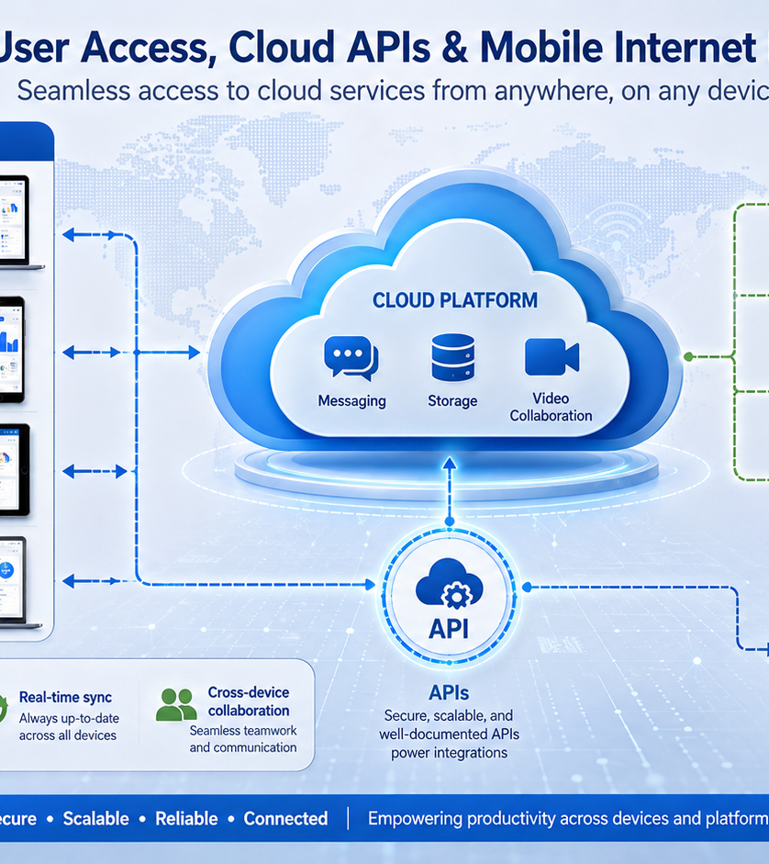
LECTURE 2
Advantages of SaaS
• Fast adoption because users can start after account setup rather than server installation.
• Lower technical administration because patching, upgrades, uptime, and platform maintenance are mainly handled by the provider.
• Easy access from different locations and devices, supporting collaboration and remote work.
• Predictable subscription pricing can simplify planning for small organisations and departments.
• Built-in integrations and APIs may connect SaaS to other systems and workflows.
ICT411 Cloud Computing • Unit 2 • Cloud Service & Deployment Models
9
Notes:
Stress that SaaS is ideal when the business need is common and does not require deep infrastructure control.

Slide 10
LECTURE 2
Disadvantages and risks of SaaS
• Less control over infrastructure, update timing, deep security settings, and some data-processing locations.
• Vendor lock-in may occur when data formats, workflows, integrations, or user habits become difficult to move away from.
• Customisation is limited compared with building or hosting a custom application.
• Internet dependency can affect productivity when connectivity is poor or the provider has an outage.
• Data privacy, compliance, and user access must be carefully reviewed before sensitive information is uploaded.
SaaS risk question:
Can we trust the provider with our users, data, uptime, and compliance obligations?
ICT411 Cloud Computing • Unit 2 • Cloud Service & Deployment Models
10
Notes:
Use the provider responsibility idea: even in SaaS, the consumer still manages accounts, permissions, data governance, training, and configuration.

Slide 11
LECTURE 2
SaaS examples
• Salesforce: customer relationship management used for sales, service, marketing, reporting, and customer data workflows.
• Microsoft Office 365: productivity and collaboration services such as email, documents, spreadsheets, meetings, and storage.
• Google Workspace: cloud-based collaboration through email, Drive, Docs, Sheets, Calendar, Meet, and shared workspaces.
• University example: use SaaS for official email, file sharing, online forms, meetings, and document collaboration.
• Professional decision: choose SaaS when speed, collaboration, and lower administration matter more than deep technical control.
Task: name one SaaS used by students and identify what the provider manages.
ICT411 Cloud Computing • Unit 2 • Cloud Service & Deployment Models
11
Notes:
These examples come directly from the attached lecture notes. Ask students to describe what they manage versus what the provider manages.

Slide 12
LECTURE 2
PaaS: Platform as a Service
• PaaS provides a managed platform for developing, testing, deploying, and scaling applications.
• Developers focus on application code, data, business logic, and configuration instead of physical servers.
• The provider manages infrastructure, operating systems, runtime environments, middleware, scaling tools, and deployment mechanisms.
• PaaS supports faster software delivery when teams want to avoid routine infrastructure administration.
• Lecture examples include Heroku, Google App Engine, and AWS Elastic Beanstalk.
PaaS = build and deploy applications without managing every server layer.
ICT411 Cloud Computing • Unit 2 • Cloud Service & Deployment Models
12
Notes:
Relate PaaS to web app projects where students deploy code and let the platform handle runtime and scaling.

Slide 13
LECTURE 2
Advantages of PaaS
• Improves developer productivity because environments, runtimes, build processes, and deployment workflows are already available.
• Reduces server administration, patching effort, and manual configuration compared with IaaS.
• Supports rapid testing, prototyping, and deployment for student projects, start-ups, and agile teams.
• Often includes monitoring, scaling, databases, logging, and integration tools that speed up delivery.
• Encourages standardisation because teams deploy through repeatable platform workflows.
Best fit
Teams that write applications and want the platform to handle most operational plumbing.
ICT411 Cloud Computing • Unit 2 • Cloud Service & Deployment Models
13
Notes:
Explain that PaaS is often a good learning bridge between coding and professional deployment.

Slide 14
LECTURE 2
Disadvantages and risks of PaaS
• Less control over the operating system, runtime internals, network layout, and some security configurations.
• Applications may need to follow platform rules, supported languages, frameworks, or deployment patterns.
• Vendor lock-in can occur when code depends heavily on proprietary platform services or APIs.
• Debugging deep performance problems may be harder because the provider hides some infrastructure details.
• Costs can grow if scaling, add-ons, databases, or traffic are not monitored.
PaaS trade-off:
more speed and less maintenance, but less low-level control.
ICT411 Cloud Computing • Unit 2 • Cloud Service & Deployment Models
14
Notes:
Tell students not to treat PaaS as magic. They still need secure coding, testing, monitoring, data protection, and cost control.

Slide 15
LECTURE 2
PaaS examples
• Heroku: deploy applications with managed buildpacks, add-ons, databases, logs, and scaling options.
• Google App Engine: build applications on Google’s managed platform using supported runtimes and automatic scaling.
• AWS Elastic Beanstalk: upload application code while AWS provisions and manages related infrastructure components.
• Student example: deploy a class project API without manually installing Apache, Nginx, runtime packages, and database clients on a VM.
• Professional decision: choose PaaS when speed of delivery is more important than full infrastructure control.
Task: identify one web app you could deploy on PaaS and list two platform services it would need.
ICT411 Cloud Computing • Unit 2 • Cloud Service & Deployment Models
15
Notes:
These are the PaaS examples in the attached PowerPoint notes.

Slide 16
LECTURE 2
IaaS: Infrastructure as a Service
• IaaS provides virtualized computing resources over the internet.
• Consumers can provision virtual machines, storage, and networking according to their requirements.
• Users usually control the operating system, installed applications, firewall rules, storage attachment, and network configuration.
• The provider manages physical data-center facilities, hardware, core virtualization, and underlying availability zones or regions.
• Lecture examples include AWS EC2, Azure Virtual Machines, and Google Compute Engine.
IaaS = rent flexible infrastructure and manage more of the software stack yourself.
ICT411 Cloud Computing • Unit 2 • Cloud Service & Deployment Models
16
Notes:
Link IaaS to VirtualBox knowledge from Unit 1: a VM in cloud is managed through provider infrastructure instead of the local lab machine.

Slide 17
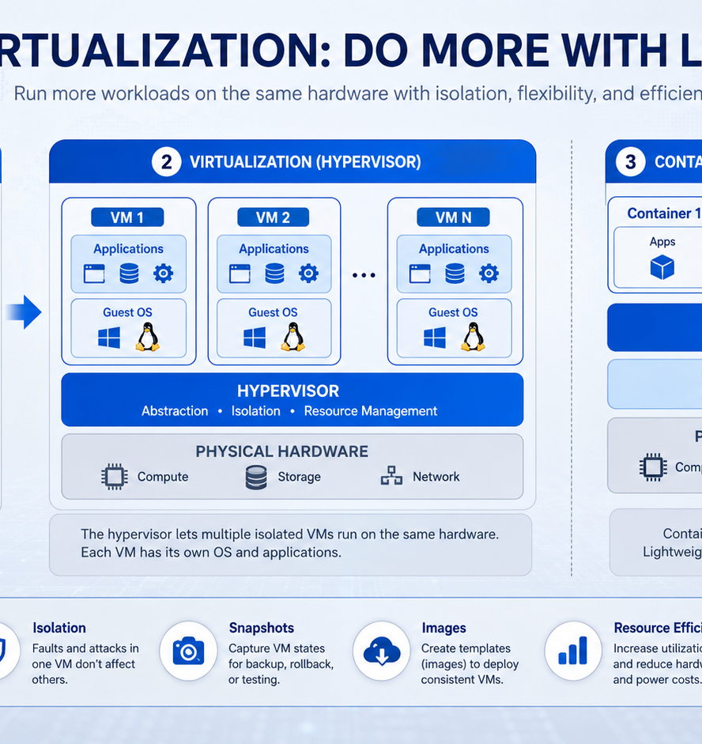
LECTURE 2
Advantages of IaaS
• High flexibility because teams can choose operating systems, server sizes, storage types, network rules, and application stacks.
• Useful for migrating existing applications that are not ready for PaaS or SaaS.
• Supports custom security configurations, specialised software, test labs, and development environments.
• Capacity can be increased or reduced faster than buying physical servers.
• Suitable for workloads requiring more control than SaaS or PaaS provides.
ICT411 Cloud Computing • Unit 2 • Cloud Service & Deployment Models
17
Notes:
IaaS is powerful because it gives control, but control also means responsibility.

Slide 18
LECTURE 2
Disadvantages and risks of IaaS
• Requires more technical skill because the consumer manages operating systems, patches, application security, backups, and monitoring.
• Misconfiguration can expose servers, databases, storage buckets, management ports, or credentials to attackers.
• Costs can rise if VMs, disks, snapshots, public IPs, or data transfers are left running without governance.
• More operational work is needed for high availability, scaling, disaster recovery, and performance tuning.
• Poor design may simply recreate an expensive traditional data center inside a cloud account.
IaaS risk question:
Do we have the skills and processes to manage what the provider does not manage?
ICT411 Cloud Computing • Unit 2 • Cloud Service & Deployment Models
18
Notes:
Emphasize that IaaS is not automatically cheaper or safer; it must be governed.

Slide 19
LECTURE 2
IaaS examples
• AWS EC2: virtual servers that can run custom operating systems and applications in Amazon’s cloud.
• Azure Virtual Machines: Microsoft cloud VMs integrated with Azure networking, storage, identity, and monitoring services.
• Google Compute Engine: Google Cloud virtual machines for custom workloads, compute clusters, and web services.
• University example: create a controlled VM lab for operating systems, networking, cybersecurity, or web server practice.
• Professional decision: choose IaaS when control, customisation, or migration needs are stronger than the desire for provider-managed simplicity.
Task: list three responsibilities a student team must manage when hosting an app on a VM.
ICT411 Cloud Computing • Unit 2 • Cloud Service & Deployment Models
19
Notes:
These IaaS examples are from the attached lecture notes.

Slide 20
LECTURE 2
Other cloud service models: MaaS and CaaS
• Monitoring as a Service provides outsourced monitoring of IT systems, applications, networks, logs, availability, and performance.
• Communications as a Service provides hosted voice, meetings, messaging, and collaboration capabilities.
• Containers as a Service lets teams upload container images while the platform runs, schedules, scales, and manages them.
• These models show that cloud services can package specialised functions, not only software, platforms, or raw infrastructure.
• When evaluating them, ask what is managed by the provider, what data is exposed, and what controls remain with the consumer.
MaaS
“We monitor your systems.”
CaaS
“We host your communication.”
Container CaaS
“We run and scale your containers.”
Always identify the responsibility boundary.
ICT411 Cloud Computing • Unit 2 • Cloud Service & Deployment Models
20
Notes:
This slide uses the MaaS and CaaS points listed in the attached lecture notes. Clarify that CaaS can mean communications as a service or containers as a service depending on context.

Slide 21
LECTURE 2
Choosing a service model: decision guide
Need a ready-made business application?
Choose SaaS
Selection criteria
Control required
Security and privacy needs
Team skills
Budget and billing risk
Integration requirements
Speed of delivery
Compliance obligations
Need to build and deploy code quickly?
Choose PaaS
Need OS, network, and server control?
Choose IaaS
Professional answer = model + justification + trade-offs.
ICT411 Cloud Computing • Unit 2 • Cloud Service & Deployment Models
21
Notes:
Make students practice decision logic rather than memorization.

Slide 22
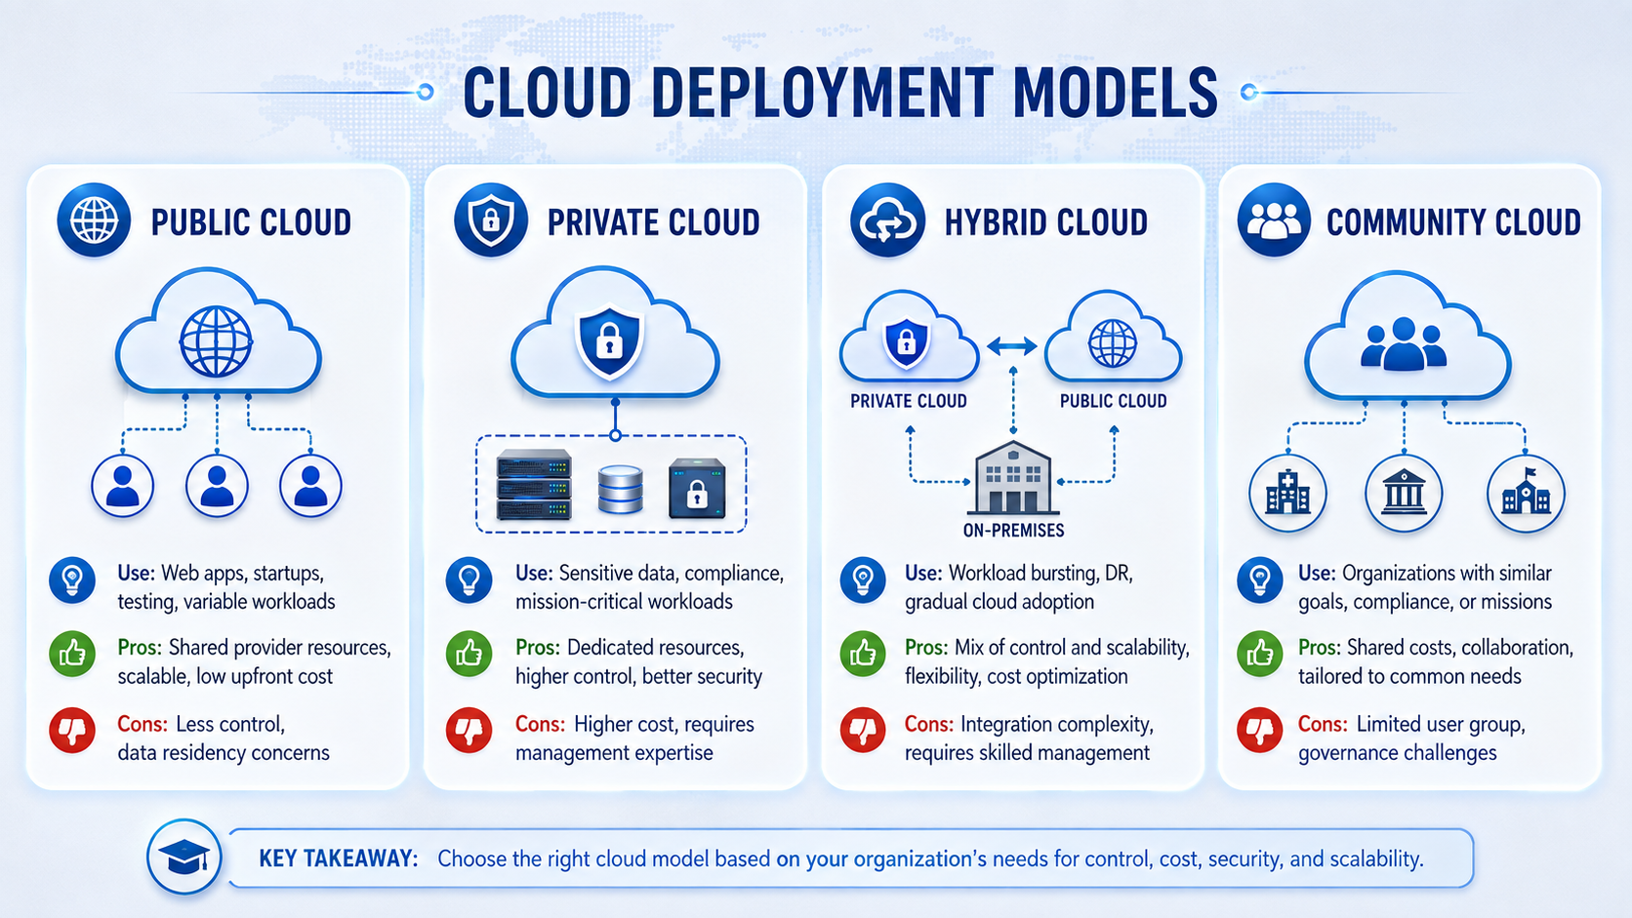
LECTURE 2
Cloud deployment models overview
ICT411 Cloud Computing • Unit 2 • Cloud Service & Deployment Models
22
Notes:
Use the visual to explain public, private, hybrid, and community cloud together before going into each model.

Slide 23
LECTURE 2
Public cloud: definition and practical meaning
• Public cloud services are provided over a public network and are available to many customers who want to use them.
• Resources are shared at provider scale, while each customer receives logical separation through accounts, tenants, networks, policies, and identity controls.
• The public cloud is normally fast to start because customers do not build the underlying data center.
• It is commonly used for websites, mobile backends, testing, collaboration, analytics, start-up products, and variable workloads.
• Lecture examples of public cloud providers include AWS, Microsoft Azure, and Google Cloud Platform.
Public cloud = provider-owned services used by many customers over standard networks.
ICT411 Cloud Computing • Unit 2 • Cloud Service & Deployment Models
23
Notes:
Emphasize that public does not mean insecure by default; it means shared provider infrastructure with strong logical controls.

Slide 24
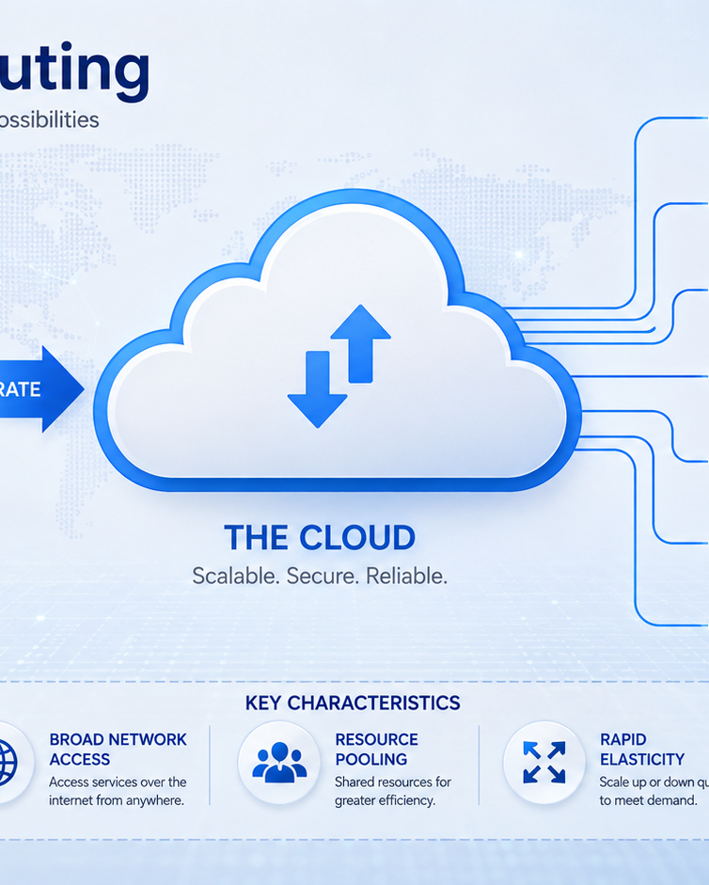
LECTURE 2
Advantages of public cloud
• Cost-effective because resources are shared across many customers and no large upfront infrastructure purchase is required.
• Highly scalable because large providers offer very large pools of compute, storage, network, and managed services.
• Quick setup allows teams to create resources and experiment within minutes when governance is in place.
• Global reach supports users in different locations through regions, availability zones, content delivery, and internet access.
• Rich service catalogues provide databases, AI, analytics, monitoring, backup, identity, and developer tools.
ICT411 Cloud Computing • Unit 2 • Cloud Service & Deployment Models
24
Notes:
These advantages expand the attached notes: low cost, scalability, easy setup, and minimal upfront investment.

Slide 25
LECTURE 2
Disadvantages and risks of public cloud
• Less direct control over physical infrastructure, hardware location, provider operations, and some security implementation details.
• Compliance and data residency concerns may arise where sensitive data must remain within specific legal or organisational boundaries.
• Performance can vary if applications are poorly designed or if network connectivity is weak between users and cloud regions.
• Limited deep customisation compared with owning dedicated infrastructure.
• Vendor lock-in and unexpected billing can occur without architecture review, tagging, budgets, and exit planning.
Public cloud question:
Do its cost and scalability benefits outweigh control, compliance, and integration concerns?
ICT411 Cloud Computing • Unit 2 • Cloud Service & Deployment Models
25
Notes:
These disadvantages build on the attached notes: less control, possible performance issues, and limited customization.

Slide 26
LECTURE 2
Public cloud examples and use cases
• AWS: widely used for EC2 virtual machines, S3 object storage, databases, networking, analytics, and many managed services.
• Microsoft Azure: strong integration with Microsoft identity, Windows environments, enterprise systems, virtual machines, databases, and developer tools.
• Google Cloud Platform: known for compute, networking, data analytics, machine learning, Kubernetes, and scalable platform services.
• Use case: host a public university website or e-learning static content with global access and managed availability.
• Use case: run development and testing environments that can be created for a class project and removed after marking.
Task: choose one public cloud provider and identify two services useful for a student project.
ICT411 Cloud Computing • Unit 2 • Cloud Service & Deployment Models
26
Notes:
These public cloud provider examples are listed in the attached PowerPoint.

Slide 27
LECTURE 2
Private cloud: definition and practical meaning
• Private cloud infrastructure is dedicated to a single organisation and may be located on-premises or hosted off-premises by a provider.
• It is designed to meet specific requirements for security, compliance, performance, control, and customisation.
• Private cloud still uses cloud principles such as resource pooling, self-service, automation, virtualization, and measured management.
• The organisation normally has more control but also more responsibility for cost, capacity planning, governance, operations, and skilled staff.
• It is common where workloads are highly sensitive, regulated, mission-critical, or tightly integrated with internal systems.
Private cloud = cloud-like capability dedicated to one organisation.
ICT411 Cloud Computing • Unit 2 • Cloud Service & Deployment Models
27
Notes:
Private cloud is not simply any local server room. It should provide cloud-like automation and service delivery.

Slide 28
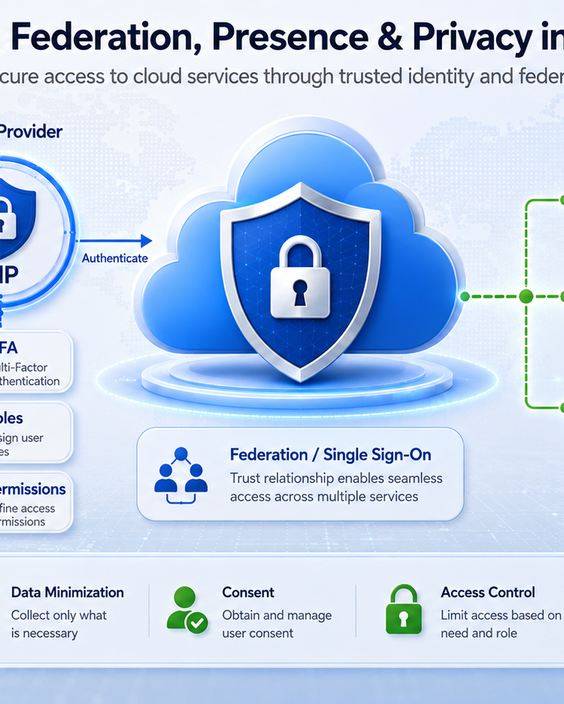
LECTURE 2
Advantages of private cloud
• Greater control over data, infrastructure design, access policies, security controls, and compliance procedures.
• Customisation can be aligned with specific organisational systems, legacy applications, performance targets, and governance processes.
• Dedicated resources may improve predictability for sensitive or mission-critical workloads.
• Data location and operational procedures can be controlled more closely than in many public cloud arrangements.
• Useful for organisations with strong internal technical teams and strict regulatory obligations.
ICT411 Cloud Computing • Unit 2 • Cloud Service & Deployment Models
28
Notes:
These advantages expand the attached notes: control, customization, security, compliance, and high performance from dedicated resources.

Slide 29
LECTURE 2
Disadvantages and risks of private cloud
• Higher cost because dedicated infrastructure, software, facilities, security, power, cooling, backup, and staff may be required.
• More in-house management expertise is needed for virtualization, storage, networks, identity, monitoring, backup, and automation.
• Scalability is usually more limited than public cloud because capacity is restricted by purchased or reserved infrastructure.
• Poorly managed private cloud can become expensive traditional IT with a cloud label.
Private cloud question:
Can the organisation afford the cost, skills, and operational discipline required?
ICT411 Cloud Computing • Unit 2 • Cloud Service & Deployment Models
29
Notes:
These disadvantages expand the attached notes: expensive, more management, and limited scalability.

Slide 30
LECTURE 2
Private cloud examples and use cases
• A bank may keep core banking workloads in a private cloud to meet strict security, audit, latency, and regulatory requirements.
• A government agency may operate citizen data systems in a private cloud to maintain stronger control over sensitive national records.
• A university may run internal examination-processing systems privately while exposing only selected services to students through controlled interfaces.
• A health institution may keep patient systems in a private environment because data privacy, audit trails, and access control are critical.
• Professional decision: select private cloud when control and compliance are more important than lowest upfront cost.
Task: identify one workload that should not be placed in a poorly governed public environment.
ICT411 Cloud Computing • Unit 2 • Cloud Service & Deployment Models
30
Notes:
Use local examples such as banking, health records, examination records, payroll, and government identity systems.

Slide 31
LECTURE 2
Hybrid cloud: definition and practical meaning
• Hybrid cloud combines public and private cloud environments, allowing flexibility and data sharing between them.
• Organisations use private environments for sensitive or stable workloads and public cloud for scalable, less sensitive, or temporary workloads.
• Hybrid cloud requires connectivity, identity integration, workload planning, monitoring, security controls, and clear data movement rules.
• The strongest hybrid designs are intentional; they are not random mixtures of disconnected platforms.
Hybrid cloud = combine strengths, manage complexity.
ICT411 Cloud Computing • Unit 2 • Cloud Service & Deployment Models
31
Notes:
This expands the attached notes: public plus private, flexibility, data sharing, optimal resource allocation, and workload portability.

Slide 32
LECTURE 2
Advantages of hybrid cloud
• Flexibility because organisations can choose the best environment for each workload.
• Cost optimisation by using public cloud resources for less sensitive, variable, or temporary workloads while keeping critical systems private.
• Enhanced security strategy because highly sensitive operations can stay in private environments under stronger organisational control.
• Supports migration in phases, reducing the risk of moving all systems at once.
• Can improve business continuity when workloads and backups are designed across environments.
ICT411 Cloud Computing • Unit 2 • Cloud Service & Deployment Models
32
Notes:
These advantages expand the attached notes: flexibility, cost-effective use of public cloud, and keeping critical operations private.

Slide 33
LECTURE 2
Disadvantages and risks of hybrid cloud
• Management is more complex because teams must coordinate two or more environments, tools, policies, networks, and monitoring systems.
• Integration challenges can appear when data, identity, APIs, and workloads must move between public and private platforms.
• Security risks increase if data transfers, VPNs, keys, identities, logs, or firewall rules are poorly configured.
• Skilled architecture and operations teams are required for orchestration, governance, automation, and troubleshooting.
• Cost control can be difficult because spending occurs in both private and public environments.
Hybrid cloud question:
Can we manage integration, security, observability, and cost across both worlds?
ICT411 Cloud Computing • Unit 2 • Cloud Service & Deployment Models
33
Notes:
These disadvantages expand the attached notes: complex management, security risks in transfers, and need for advanced expertise.

Slide 34
LECTURE 2
Hybrid cloud examples and use cases
• A university keeps examination records private but hosts the public admissions portal in public cloud during peak application periods.
• A bank keeps core banking private while using public cloud analytics for anonymised or approved reporting data.
• A hospital keeps patient records in a private environment but uses public cloud collaboration tools for non-sensitive administrative work.
• A company uses public cloud for disaster recovery copies while production remains in a private environment.
• Professional decision: choose hybrid cloud when different workloads have different sensitivity, scalability, and cost requirements.
Task: split a student-registration system into public, private, and shared components.
ICT411 Cloud Computing • Unit 2 • Cloud Service & Deployment Models
34
Notes:
Use this to prepare students for the practical case study.

Slide 35
LECTURE 2
Community cloud: definition and practical meaning
• Community cloud is shared among a specific community or group of organisations with similar goals, missions, risks, or compliance needs.
• It can serve government agencies, educational institutions, research organisations, healthcare networks, or sector-specific consortia.
• The cloud is designed around common requirements rather than open use by the general public.
• Costs, policies, governance, and services may be shared across the participating organisations.
• It is useful when organisations need collaboration but also need standards that match their community.
Community cloud = shared cloud for a defined group with common needs.
ICT411 Cloud Computing • Unit 2 • Cloud Service & Deployment Models
35
Notes:
This follows the attached notes: shared among a specific community and tailored to common compliance or mission needs.

Slide 36
LECTURE 2
Community cloud: advantages, disadvantages and examples
Advantages
Disadvantages
• Shared costs among participating organisations.
• Services and controls can be tailored to common community requirements.
• Improves collaboration among organisations with similar needs.
• Can support common compliance, data-sharing, and governance standards.
• Limited to the specific community, so it may not serve wider users.
• Governance disagreements may arise over cost, control, priorities, and usage.
• Less flexible than public cloud when the community has strict policies.
• Requires coordination, trust, contracts, and shared operational rules.
Examples: university research consortium • government shared services • healthcare reporting network
ICT411 Cloud Computing • Unit 2 • Cloud Service & Deployment Models
36
Notes:
Community cloud advantages and disadvantages come from the attached PowerPoint notes, expanded with practical governance explanation.

Slide 37
LECTURE 2
Comparing deployment models
Model
Best for
Advantages
Disadvantages
Examples
Control
Public
Variable workloads
Low upfront cost, scalable
Less control, compliance concerns
AWS, Azure, GCP
Low-Med
Private
Sensitive workloads
Control, customisation
Higher cost, skills required
Bank, govt, health
High
Hybrid
Mixed sensitivity
Flexibility, phased migration
Complex integration
Registration + records
Med-High
Community
Shared mission
Shared cost, tailored rules
Governance conflicts
Research, health network
Shared
Choose the model that best matches data sensitivity, cost, control, scalability, skills, and legal requirements.
ICT411 Cloud Computing • Unit 2 • Cloud Service & Deployment Models
37
Notes:
Walk students through the matrix row by row. Ask what changes if the workload is public website vs student records.

Slide 38
LECTURE 2
Unit summary and exit ticket
• SaaS delivers complete applications; it is fast and convenient but offers less technical control.
• PaaS gives developers a managed application platform; it improves delivery speed but may limit deep customisation.
• IaaS provides virtualized infrastructure; it offers more control but requires more management responsibility.
• Public cloud is scalable and cost-effective; private cloud offers control; hybrid combines environments; community cloud serves shared mission groups.
• Exit ticket: recommend one service model and one deployment model for a clinic appointment system, with one advantage and one disadvantage for each.
ICT411 Cloud Computing • Unit 2 • Cloud Service & Deployment Models
40
Notes:
End with the exit ticket so students practise professional justification.

